Slide 1

Automobile Fuel Economy
EDA & LR Modeling
Analysis by Alejandro Hohmann
Repository: https://github.com/gojandrooo/GA-Data-Science-Final-Project

Slide 2

Large Data Set
38,113 rows
81 columns

Slide 3
Target: MPG – But which measure?
City MPG (FT1)
Unrounded City MPG (FT1)
City MPG (FT2)
Unrounded City MPG (FT2)
City Gasoline Consumption (CD)
Highway MPG (FT1)
Unrounded Highway MPG (FT1)
Highway MPG (FT2)
Unrounded Highway MPG (FT2)
Highway Gasoline Consumption (CD)
Unadjusted City MPG (FT1)
Unadjusted Highway MPG (FT1)
Unadjusted City MPG (FT2)
Unadjusted Highway MPG (FT2)
Combined MPG (FT1)
Unrounded Combined MPG (FT1)
Combined MPG (FT2)
Unrounded Combined MPG (FT2)

Slide 4
Target: MPG – But which measure?
City MPG (FT1)
Unrounded City MPG (FT1)
City MPG (FT2)
Unrounded City MPG (FT2)
City Gasoline Consumption (CD)
Highway MPG (FT1)
Unrounded Highway MPG (FT1)
Highway MPG (FT2)
Unrounded Highway MPG (FT2)
Highway Gasoline Consumption (CD)
Unadjusted City MPG (FT1)
Unadjusted Highway MPG (FT1)
Unadjusted City MPG (FT2)
Unadjusted Highway MPG (FT2)
Combined MPG (FT1)
Unrounded Combined MPG (FT1)
Combined MPG (FT2)
Unrounded Combined MPG (FT2)

Slide 5
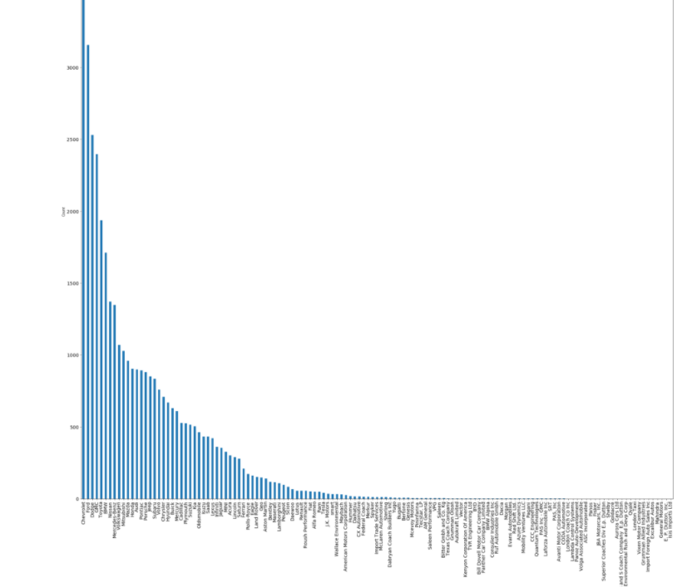
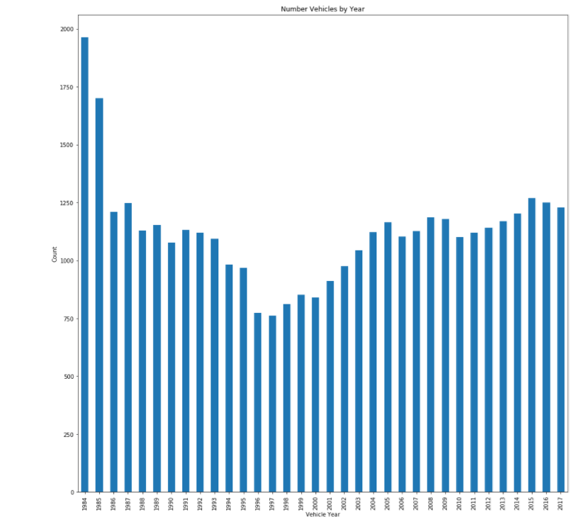
Feature Columns?
133 of Vehicle ‘Makes”
‘Years’ 1984 - 2017

Slide 6
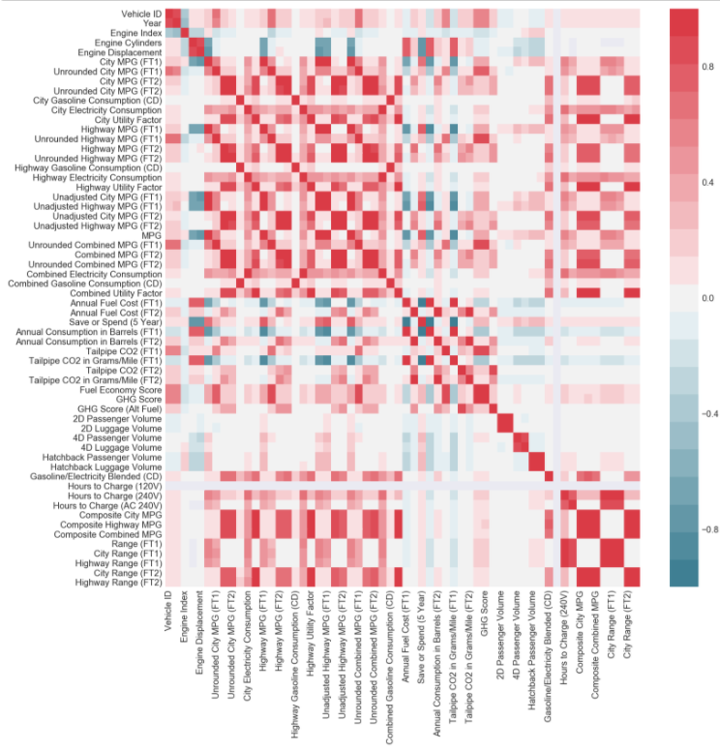
Selecting Feature Columns - Numerical
Target features that show correlation using heatmap
Use logic to disregard features with collinearity (e.g. ‘City MPG’)

Slide 7
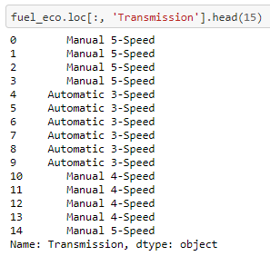
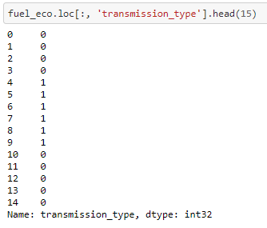
Feature Columns - Categorical
Dummy coding categorical variables

Slide 8
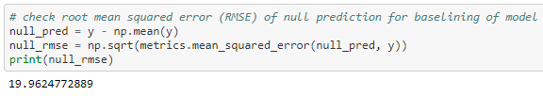
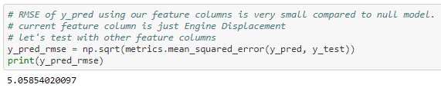
Root Mean Squared Error: Null vs. Regression
Null Model
Regression with ‘Year’ as Feature Column

Slide 9
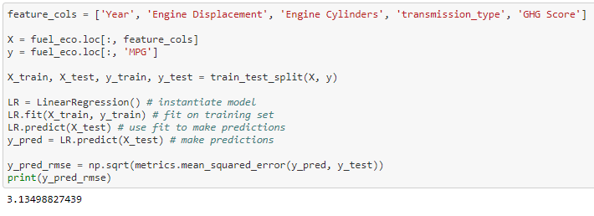
Additional Feature Columns Improve Model
Additional Features Bring Down RMSE

Slide 10

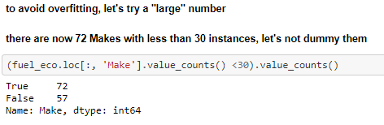
Add Dummy Variables for ‘Make’
But we have 133 makes…
Many of which there is only one instance
So filtered out ‘makes’ with less than 30 instances

Slide 11
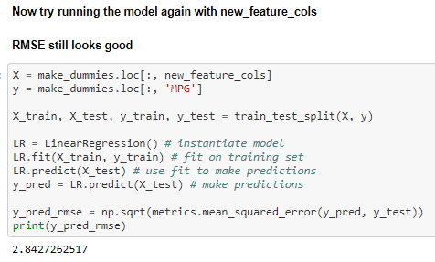
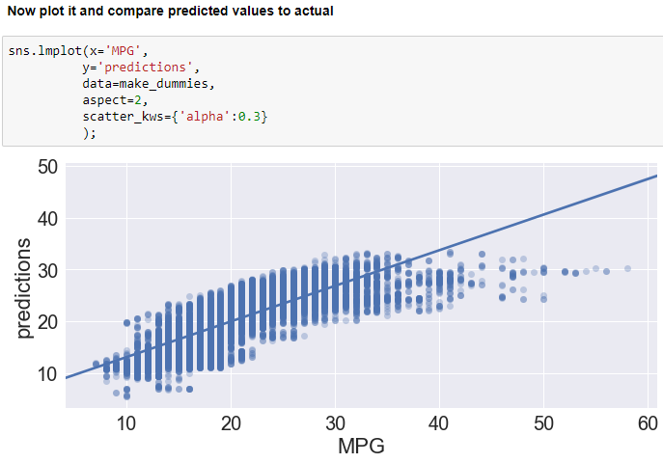
Best model yet – time to apply it
RMSE
Predicted Value plotted

Slide 12
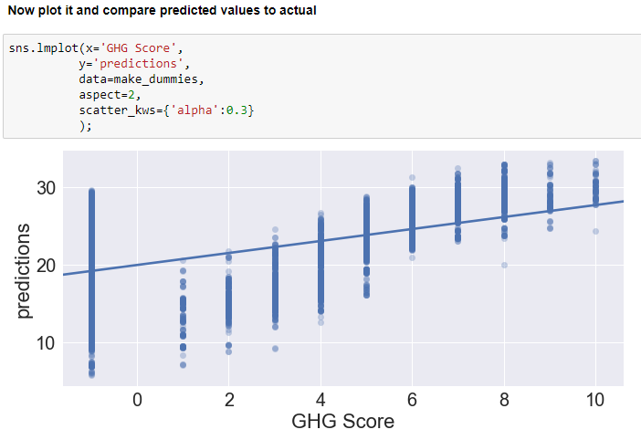
Best model yet – time to apply it
RMSE

Slide 13
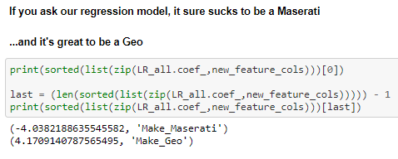
Examine Coefficients
Model is still probably overfitting
Would like to try with same features but for different ‘Makes”

Slide 14
Fin
Presentation parameter:
5 mins to present

